Slide 1
Migration to Microservices
Lecturer: Ngo Huy Bien
Software Engineering Department
Faculty of Information Technology
VNUHCM - University of Science
Ho Chi Minh City, Vietnam
nhbien@fit.hcmus.edu.vn

Slide 2

Objectives
To migrate a monolith to microservices.

Slide 3

Contents

Slide 4

References
Miika Kalske et al. (2018). Challenges When Moving from Monolith to Microservice Architecture.
Sam Newman (2019). Monolith to Microservices - Evolutionary Patterns to Transform Your Monolith. O'Reilly Media.

Slide 5

Why? (Ngo's Opinion) (I)
Reason 1: You want to have several independent development teams.
Reason 2: You want or your client wants to have a faster and modern UI (i.e. SPA) that is totally decoupled from the other parts of the system while the old technologies (like ASP.NET Web Forms or WordPress) cannot provide it.
Reason 3: You do or your client does have performance or scalability issue with the legacy system.

Slide 6
Why? (Ngo's Opinion) (II)
Reason 4: You find that is too difficult to add a new feature to the legacy system because it is too complicated.
Reason 5: You want or your client wants that some parts of your system (e.g. user store and authentication) can be shared among or reused by multiple different systems.
Reason 6: You want or your client wants your system to be able to scale out easily later.
Reason 7: You want or your client wants that a part of your system can be revised or extended or replaced easily later.

Slide 7
Further Reading
Armin Balalaie et al. (2015). Migrating to Cloud-Native Architectures Using Microservices: An Experience Report.
Jean-Philippe Gouigoux and Dalila Tamzalit (2017). From Monolith to Microservices - Lessons Learned on an Industrial Migration to a Web Oriented Architecture.
Antonio Bucchiarone et al. (2018). From Monolithic to Microservices: An Experience Report from the Banking Domain. IEEE Software.
Nabor C. Mendonca et al. (2021). The Monolith Strikes Back: Why Istio Migrated From Microservices to a Monolithic Architecture. IEEE Software.

Slide 8
https://aws.amazon.com/porting-assistant-dotnet/
https://tomasherceg.com/blog/post/modernizing-asp-net-web-forms-applications-part-2
https://www.dotvvm.com/modernize

Slide 9


Slide 10
Implement a New Feature (I)
When implementing new functionalities, they should not be appended to monolith even though it might be faster.

Slide 11
Implement a New Feature (II)
Implement a new feature as an independent module.
.NET example:
Create a new folder in framework codebase for the feature.
Create a new folder in module codebase for the feature.
Create new namespaces for the feature.
Create new database schema for the new feature.
SQL server example:
New fields and stored procedures may be created in the existing database schema first.
Move the new fields and stored procedures to separate tables/objects, then to a separate database.
Some fields may be denormalized (i.e. be duplicated in several databases)

Slide 12
Implement a New Feature (III)
Modify data access (persistence) code to access the new tables or data objects or database.
Fields properties may be changed.
Unit tests passing
Modify stored procedures of the existing features.
Modify related CRUD code of the existing features.

Slide 14
1. Achieve Good Test Coverage [1]
It can take a lot of time and effort to refactor the services out from the monolithic architecture.
This is why the refactoring towards microservices should be done in small parts.
It is extremely important to be careful when doing this refactoring, because there is the possibility of introducing new bugs in existing features. This is why good test coverage is needed before starting this process.

Slide 15
2. Identify Microservices
The first thing to do is to define the microservices and their responsibility areas.
This is important, because it is expensive to make a lot of changes across the services.
This is where the earlier experience working with monolith and designing its components is helpful as developers should already have a good understanding about the business concepts of the application.
It is probably best to start from the easiest and most obvious services and when the organization has more knowledge about microservice architecture then the services can become more fine-grained.

Slide 16
3. Automate Deployment Process
There can be hundreds of different services running in production and many services can have multiple instances running to comply with the scale that is needed from the application.
This big amount of microservices organizations run in production means that there has to be tools to automatically to deploy, scale and manage these services.

Slide 17
4. Set Up Logging and Monitoring
In case of failures, there needs to be good logging in microservices.
This logging has to be easily searchable and all services should aggregate logs to one place so problem finding becomes easier.

Slide 18
5. Build Fault-Tolerant Services
With distributed system that has a lot of services it is inevitable that at some point a service might be under heavy load and cannot respond in timely manner or the service might down.
Circuit breaker pattern handles failures fast and can provide fallback which returns default data instead of waiting for the response from a dependency.
Circuit breaker monitors for failures and when there are enough failures the subsequent calls to the dependency won’t be made and instead an error is returned.
This means that instead of adding more load to the dependency by making new calls to it, an error is returned immediately to the user which gives the dependency time to recover from the load.

Slide 19
6. Accept Eventual Consistency
When there are multiple services which each have their own database the transactions are harder to handle and more time needs to be spent dealing with the transactions.
Instead of transactions microservices can agree on eventual consistency of data.
This means that the changes done by other services might not be persisted immediately, but they will be eventually persisted, when the service has processed the message.
If previously the user had to wait for the whole transaction to complete now the user might not be able to immediately explore the data that the dependency service will create.

Slide 21
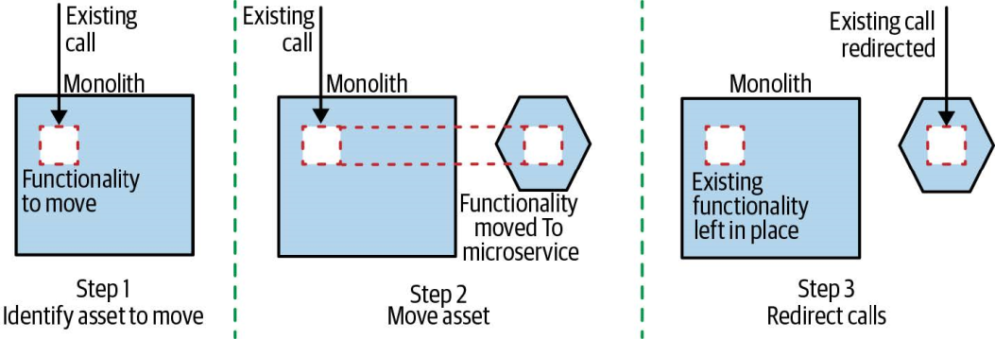
The Strangler Pattern [2]
To move functionality over to your new services architecture without having to touch or make any changes to your existing system.

Slide 22
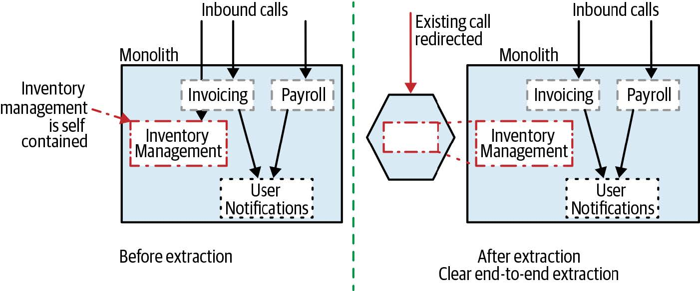
End-to-End Extraction
Occasionally, you can extract an entire end-to-end slice of functionality in one piece.
In order to perform a clean end-to-end extraction like this, you might be inclined to extract larger groups of functionality to simplify this process.
By extracting larger slices of functionality, you are taking on more work, but may simplify some of your integration challenges.

Slide 23
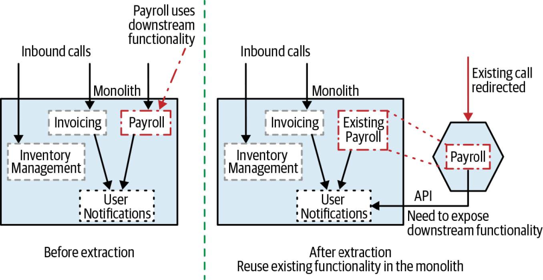
“Shallow” Extraction
Rather than also reimplementing the User Notifications functionality, we expose this functionality to our new microservice by exposing it from the monolith—something that obviously would require changes to the monolith itself.

Slide 24
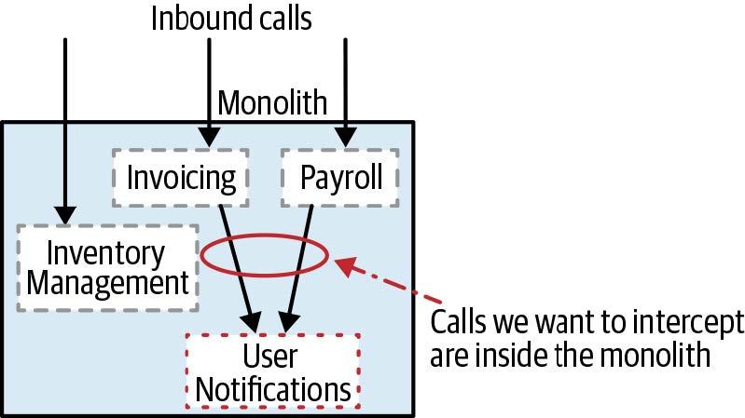
Strangler Fig Pattern Drawback
The strangler fig pattern doesn’t work too well when the functionality to be moved is deeper inside the existing system.

Slide 25
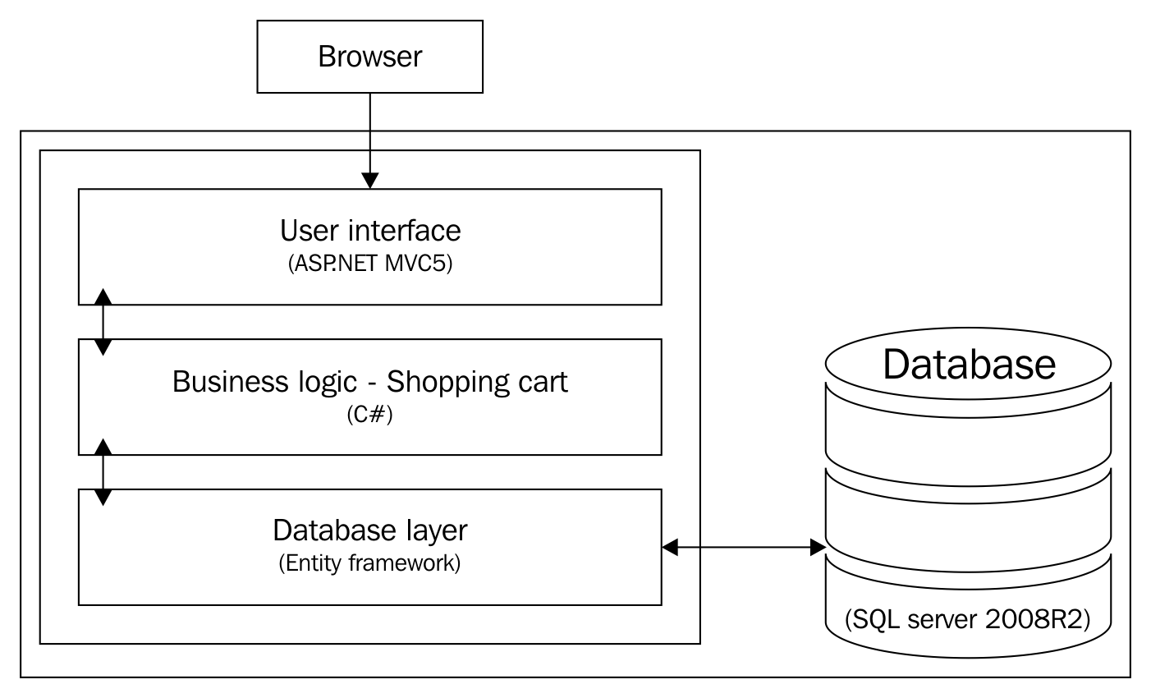
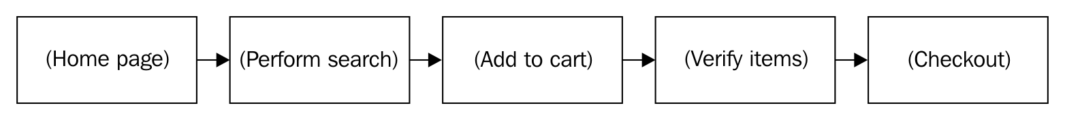
Example

Slide 26
Segregate Modules
Move an existing feature to a separate module.

Slide 27
Reduce Module Interdependency
Load libraries dynamically.
Divide UIs into separate pages and modules.

Slide 28
Migration Example
Tools: ASP.NET Core, C#, Entity framework (EF)
Basic steps
Creating our project
Adding a model (POCOs)
Adding repositories
Registering the repositories
Adding controllers
Adding EF core support
Adding EF contexts
Registering the contexts
Migrating database
Adding a view model

Slide 29
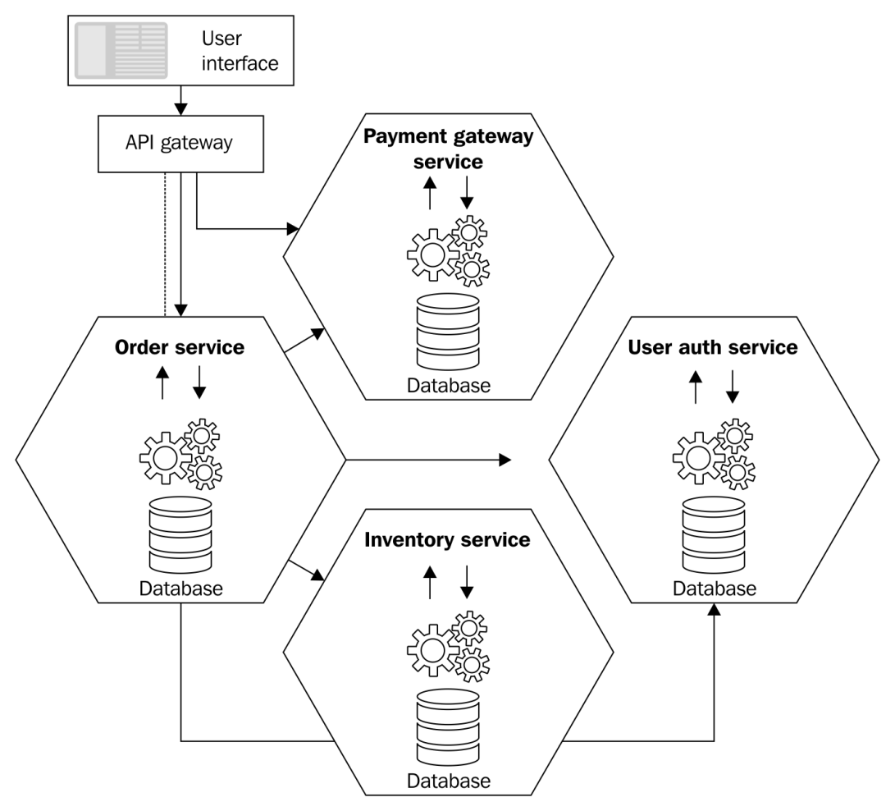
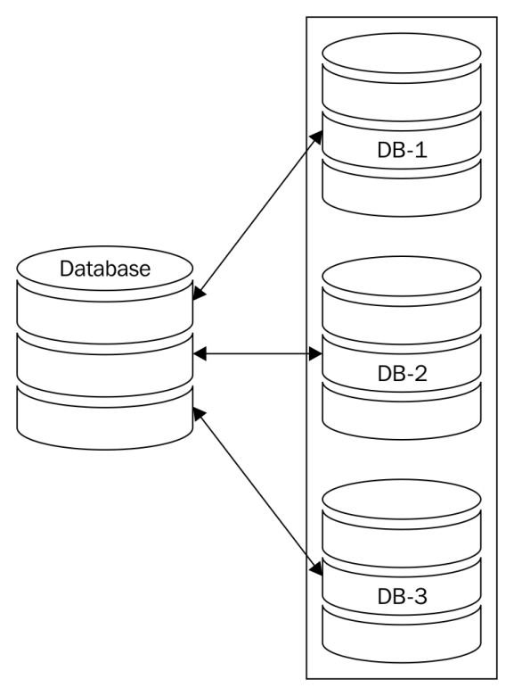
Database Sharding
Sharding comes from shard and spreading, which means dividing a database into chunks (shards) and spreading to different servers.

Slide 30
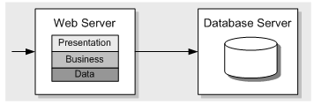
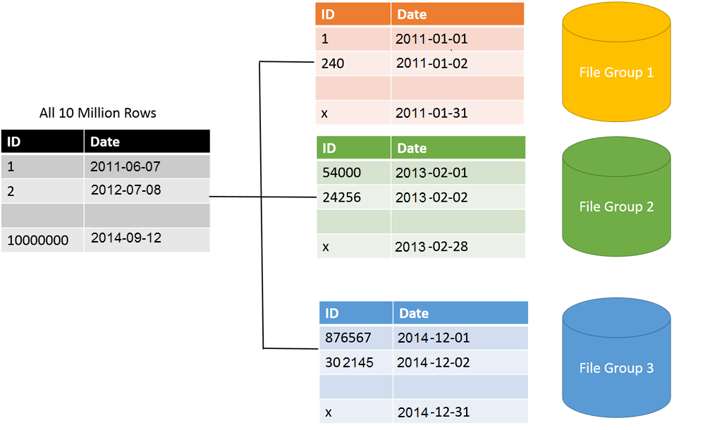
Database Partitioning

Slide 31
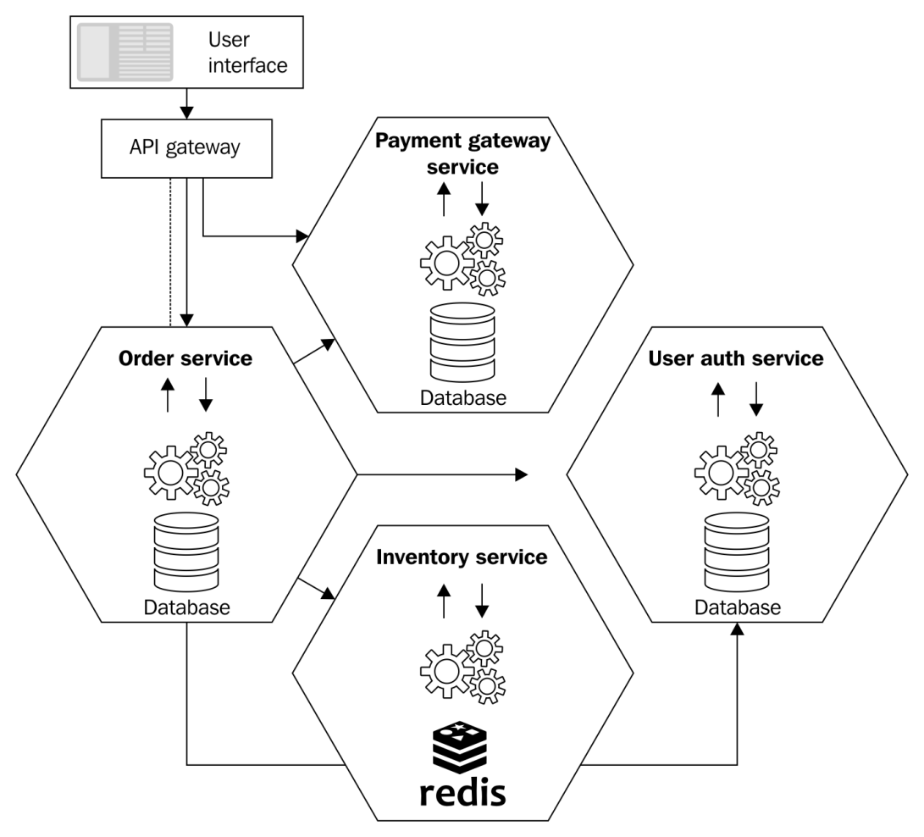
Decomposition Candidates
Deployment
Modifiability
Scalability

Slide 32
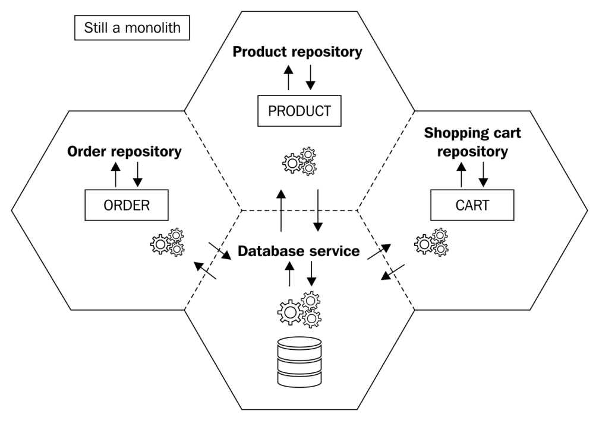
Splitting Database Access Layer

Slide 33
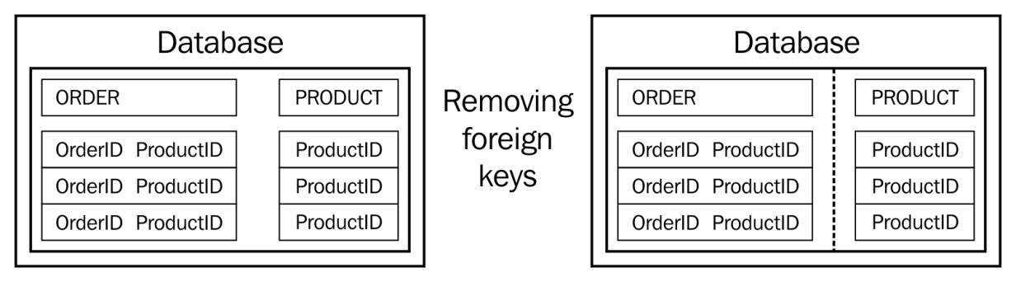
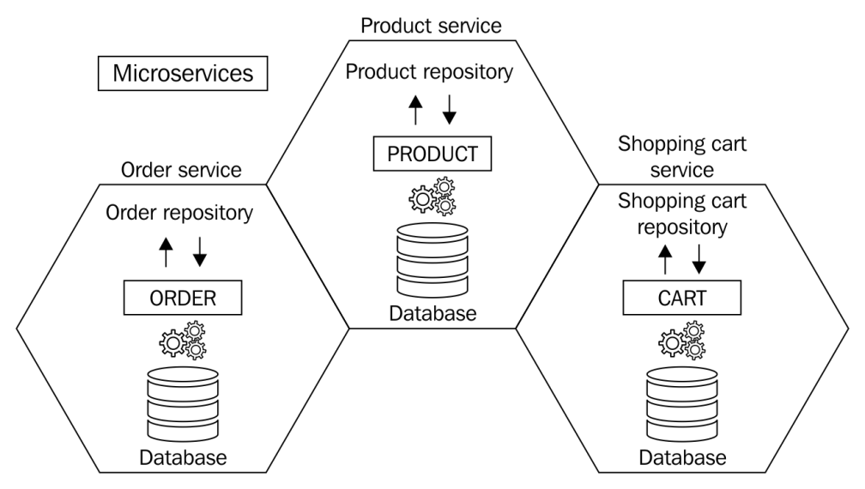
Removing Foreign Keys

Slide 34
Configuration Data
Configuration files
Hard-coded values
Separate services

Slide 35

Further Reading
Armin Balalaie et al. (2015). Migrating to Cloud-Native Architectures Using Microservices: An Experience Report.
Antonio Bucchiarone et al. (2018). From Monolithic to Microservices - An Experience Report from the Banking Domain. IEEE Software.
Anup K. Kalia et al. (2021). Mono2Micro - A Practical and Effective Tool for Decomposing Monolithic Java Applications to Microservices.pdf

Slide 36

Thank You & See You Again

